Slide 1

Notes:
. Our Employability service launched in 2016, with the aim of creating opportunities for people in recovery.
Our team provide person centered support to enable individuals to explore new pathways to positive destinations.

Slide 2
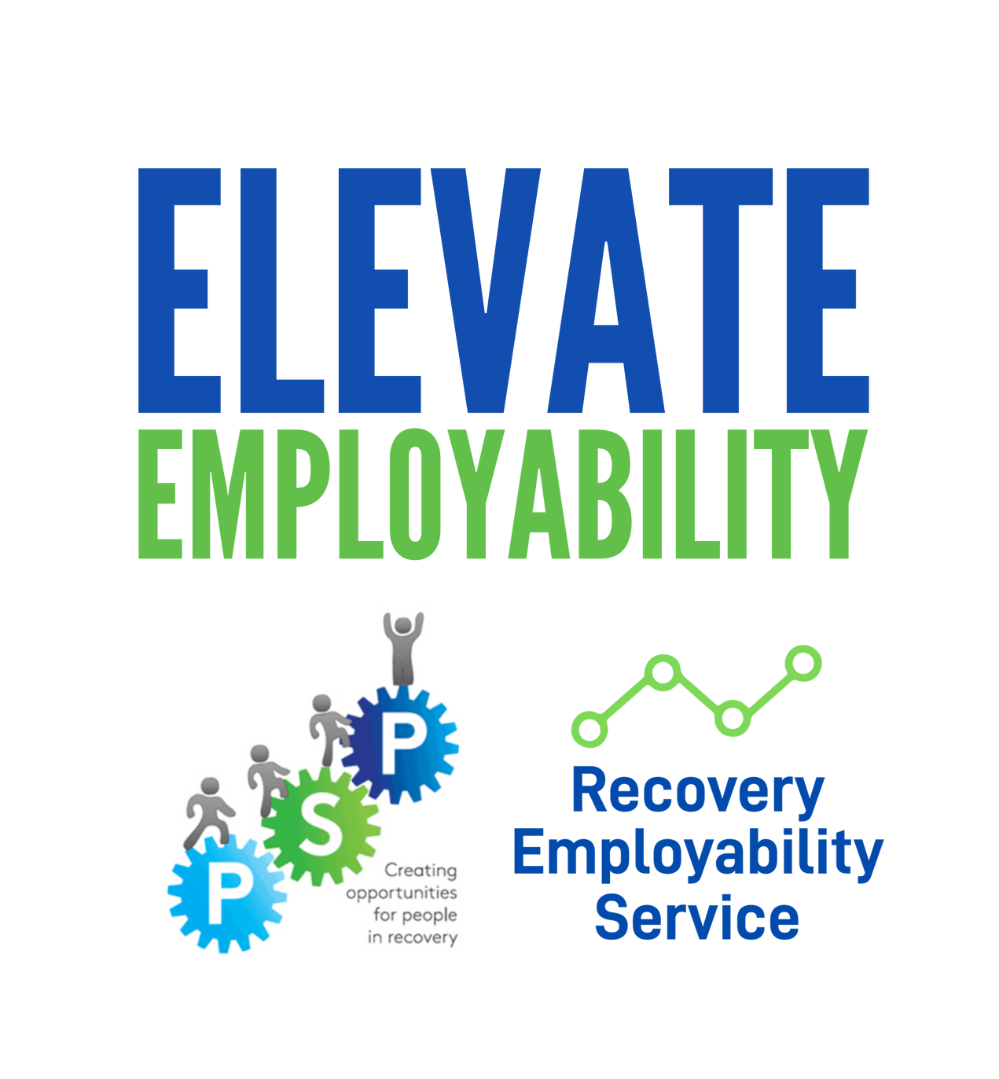



















Agenda
Meet and understand our Employability service
How we begin engagement
Who can we support
How do we support
Case studies
Notes:
Hopefully this presentation will provide insight to who we are, who we can support, have we support, and I have included a few case studies to illustrate how diverse the experience of engaging with our service is, I have also included information on how to refer.

Slide 3
Elevate PSP
Public Social Partnerships (PSPs) are strategic partnering arrangements, through which the public sector can collaborate with third sector organisations to share responsibility for designing services.
Asset based approach to bridge the gap from treatment and care to sustainable recovery emphasising the positive contribution individuals can make to the personal, social and economic wellbeing of their community.
Designed co-productively with participants and partnership working is inherent in the process.
We deliver a variety of employability support services either directly by Elevate or through our partner organisations.
Notes:
Based at GCA we operate similar to a hub. we utilize the strengths of our immediate partners and other organizations through.
For example, some courses are delivered internally, however we refer participants to other opportunities such as learning with partners.
example -introduction to computers which is facilited by Glasgow life – podcast WAWY/NCL – ST Giles.
We listen to what barriers are presented by participants and work to create programs to tackle these.

Slide 4
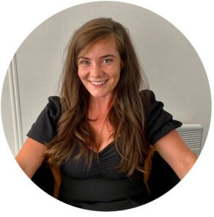
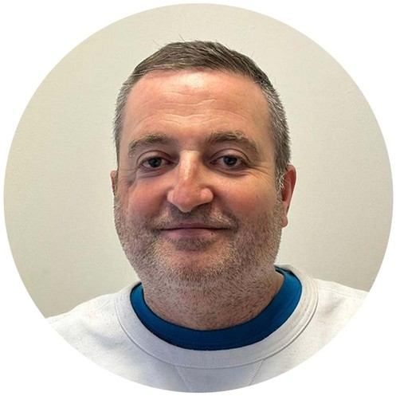
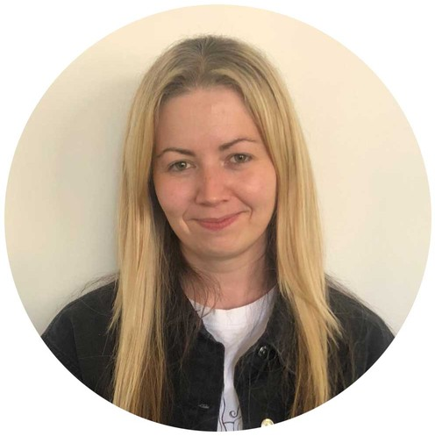
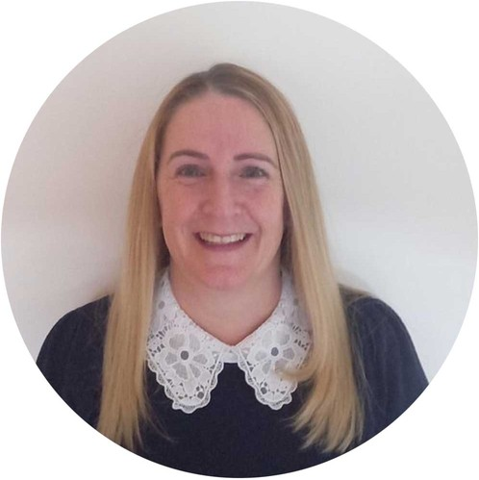
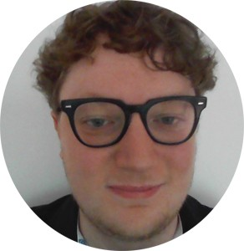
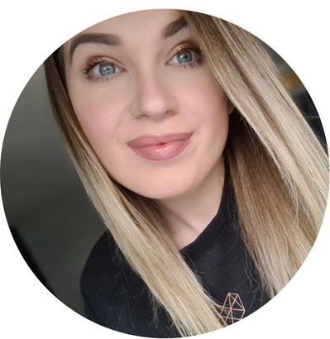
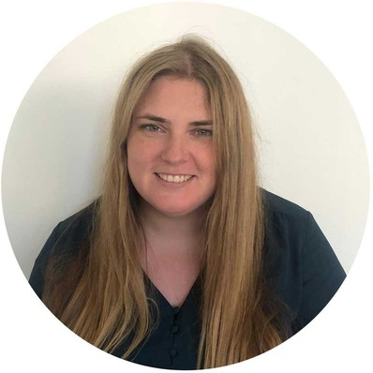
Meet the Team
Notes:
5 support workers from varied backgrounds and a administrator who is the back bone of the team.

Slide 5

Who we can support?
Employability service for people in recovery from drugs/or alcohol
Glasgow City Postcode
Individuals who are ready to focus on employability
Notes:
Harm reduction

Slide 6
How to refer
Website!
Notes:
Service and self referrals

Slide 7
What happens next.
What to include, What to expect,
What happens next
Meet the worker for a chat, complete registration
Referral Received Allocated to a worker 2 working days.
Triage Call to discuss needs and support available within a week of referral
Notes:
Barriers to employment – history – key info – best time to contact – any existing goals
During the triage we get the first glimpse and what services will be able to support the recovery journey

Slide 8

How do we support?
PERSONAL SITUATION
Finances, benefits, housing, & relationships
HEALTH & WELLBEING
Physical & mental health recovery
RELEVANT SKILLS AND ABILITIES
Job-specific and transferable
EMPLOYABILITY
Finding opportunities, filling in forms, & preparing for interviews
SELF-CONFIDENCE
How participant feels about themselves & their future
Notes:
Like the Maslow hierarchy of needs, we work with the participants to explore each level of our appraisal to build an action plan to meet employability goals and sustain recovery .
We are by no means experts when it comes to benefits, we can be there as emotional support while providing a safe space to ask any question and guidance through the paperwork.
Again, here is where we identify other organizations that can build the individuals recovery capital
Elevate essentials – appraisal while increasing social capital – identify partners to onwards referral

Slide 9

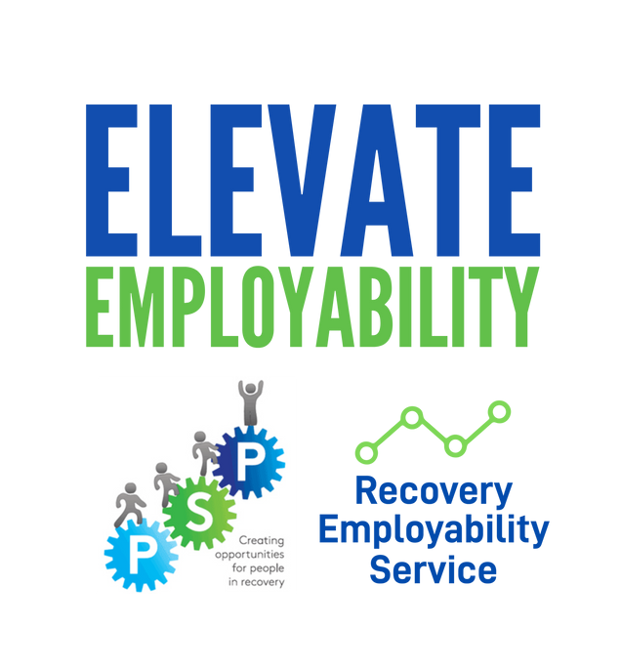
Opportunities

Slide 10

Participant Journeys
I heard about Elevate through my addictions worker and I thought Elevate would be good to get involved with as the next step in my recovery. I wasn’t sure what I wanted to do. I was open to opportunities and wanted to maybe do group work, that is when I started the Elevate Essentials course on Zoom which helped build my confidence and make new friends. My worker then referred me to the Woman’s group at GCA. I have also got involved in the Back on the Road project where I was volunteering for 20 weeks restoring old buses and have just got my level 6 community achievement award. I have built my confidence and met new people and learned new skills. I have recently started a level 1 Reiki course through Glasgow Clyde college. I am doing this with Friends I have made through Elevate.

Slide 11
Participant Journeys
Participant B engaged with Elevate in august 2020 Participant B was referred by our partner Phoenix Futures. His recovery journey has had ups and down, his efforts and development since becoming a participant have been impressive. Participant B has used his administrative skills to volunteer with partners. As well as Erasmus Trip to Italy July 2022. Participant B has embarked on numerous training and education courses including, ABI training in GCA, a Podcasting course, a Web design course, Intro to Psychology SCQF level 5 and is Currently awaiting a community achievement award. Participant Bs’ future plans are to return to education, Participant B will be starting an Access to humanities this year and is looking forward to starting volunteering position as a befriender.

Slide 12
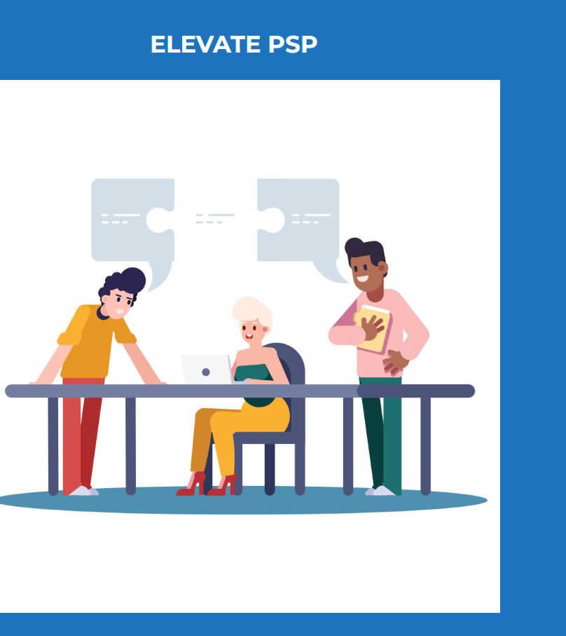


RECOVERY EMLOVABILITY SERVICE
--
0

